Slide 1
Window Functions
Advanced SQL for Analysts

Slide 2
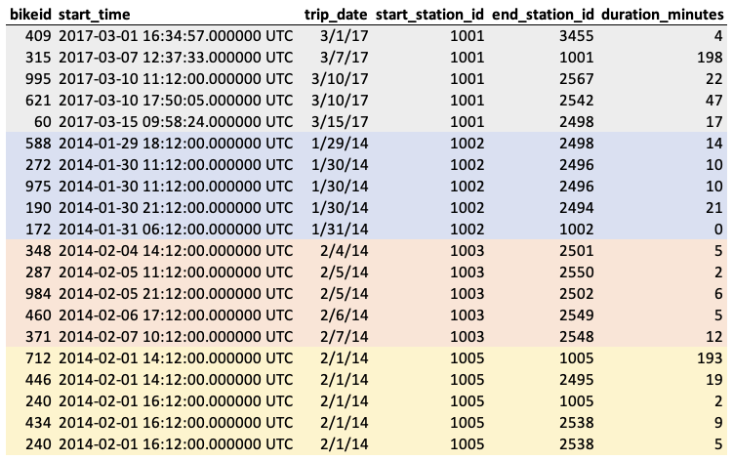
What is it?
A window function, also known as an analytic function, computes values over a group of rows and returns a single result for each row. This is different from an aggregate function, which returns a single result for a group of rows.
result
Notes:
Analytic function would produce a result for every row
Can do calculations w/in a “partition” or group
Calculation done subject to ordering
Calculation done subject to a “frame” of rows

Slide 3
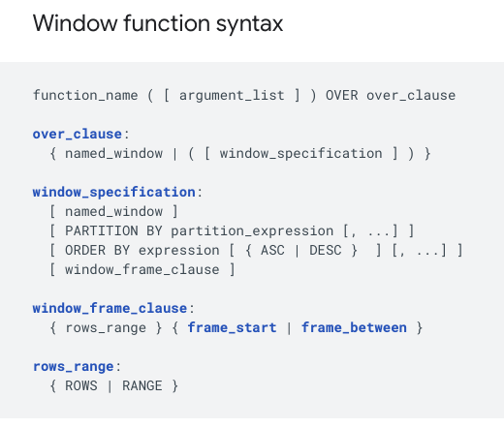
Anatomy of a window function call
Not all parts of the call are required for all functions
Some are optional depending on what you’re doing

Slide 4
Types of functions
Standard aggregation functions
Sum
Average
Min
Max
Ranking functions
Rank/dense rank
Row number
Ntile
Positional functions
Lead
Lag
First_value
Last_value

Slide 5
Standard functions
Typical usage:
Total of all rows (sum or average)
Cumulative calculation (usually a sum)
Rolling calculation (usually an average)
Rolling max – check if something has happened
Things to know:
If doing total, really only need to specify “over” and nothing else
Cumulative and rolling calculations will require you specify the row frame
Should specify the order by no matter what as a best practice, you never know what you’ll get if you don’t

Slide 6
Aggregation functions exercise
Start with query provided and calculate the following
Grand total of duration_minutes
Grand total by bike
Cumulative total of minutes
Cumulative total by bike
Cumulative total by bike and day
Rolling average of last 5 trips by bike

Slide 7
Ranking functions
Typical usage
Get order for some variable
Maybe atypical usage:
Decide how to filter rows
De-duping data
Things to know:
Don’t work like normal functions, typically don’t take an argument (depends on platform)
Will require an “order by” clause
Use “desc” to order descending

Slide 8
Differences in ranking functions
RANK
Returns an integer rank
Will generate the same integer if there’s a tie
Will skip ranks when there is a tie
DENSE_RANK
Returns an integer rank
Will generate the same integer if there’s a tie
Will not skip ranks when there is a tie (always produces sequential integers)
ROW_NUMBER
Returns sequential integers
Never generates the same integer
There are never ties (seems like that’s obvious by now)
NTILE
Splits rows into groups using integers
Will generate the same integer across rows
Ranks not skipped

Slide 9
Ranking function exercises
Start with query provided and calculate the following
Overall rank by ride duration
Overall dense_rank by ride duration
Row number by ride duration
NTILE(4) by ride duration
Repeat all by bikeid
Return the most recent trip by bike
Return the longest trip by bike

Slide 10
Positional functions
Typical usage
Look up a value in the past or future
Repeat a value across rows
Nice for calculating percentage increase/decrease
w/o window functions generally need a self-join
Self-joins are not easy to read (and might not be super performant)

Slide 11
Positional function summary
LEAD/LAG
Looks forward (lead) or back (lag) by some step.
Will require an order by statement
Values will not be repeated
Will return null values depending on how many steps are requested
FIRST_VALUE/LAST_VALUE
Pulls the first or last value subject to parameters
Will require an order by statement
Values always repeated
Will not return null values

Slide 12
Positional exercises
Start with query provided and calculate the following
Time since last start by bike
Return the first start time of the day by bike
Calculate the total number of minutes by day and bike and then show the percent increase/decrease for each day.
Calculate the number of trips per month and bike. Calculate the percent increase/decrease for each month.

Slide 13
Constructing a transition variable
Say we want to partition the data anytime the time between starts for a bike is more than an hour.
Looking to string together a set of trips that all happen within an hour of each other.
Want to know the average time the bike was being ridden and the average time it waited within each of these blocks of time.

Slide 14


